Slide 1
7.2 Resume Writing

Slide 2
Objective
Objective
Create, format, and distribute a complete resume that accurately represents your skills, experience, and educational background

Slide 3
Introduction
Introduction
Q. What is a resume?
A document that summarizes your skills, experience, and educational experience.
Employers look at resumes to find qualified employees.

Slide 4
Instroduction
Introduction
Q. Who needs a resume?
EVERYBODY who wants a job needs a resume!
Q. Why is a resume important?
It is the first step to getting an interview.

Slide 5
Instroduction
Introduction
Q. How have resumes changed with technology?
Resumes are created and distributed using computers.
Q. What makes a resume “good?”
A good resume should tell your story
Concise and easy to read

Slide 6
Instroduction
Introduction
Q. How long does an employer typically look at a resume?
Less than one minute!

Slide 7
Anatomy of a Resume

Slide 8
Contact Information
Part 1: Contact Information
[FIRST NAME] [LAST-NAME]
[Permanent Address]
[Phone number]
[E-mail]

Slide 9
Professional Email Address
Professional Email Address
ChunkyMunky3@mail.com | MiguelAGuzman@yahoo.com
iHatework@yahoo.com | Fred.scharpling@gmail.com
hawtleggzzzz@att.com | cbloom@gmail.com

Slide 10
Professional Summary or Career Objective
Part 2:
Professional Summary
or
Career Objective?

Slide 11
Comparing
Professional Summary
Highlights your 3-4 best qualities
Offers a snapshot of your career and areas of expertise
Preferred by most employers today
Career
Objective
One sentence statement of employment goals
Desired job title, industry, environment
Good for job-seekers without a lot of experience

Slide 12
Bulleted List
Paragraph
Experienced bookkeeper with proven proficiency handling complex accounting in a large international corporation. Utilize strong communication skills with expert ability to manage staff. Effectively prioritize multiple projects and meet deadlines.
Experienced and motivated Administrative Specialist for major hospital
Exceptional analytical skills, and detail oriented
Optimize policy implementation through innovative communication strategies

Slide 13
Work Experience
Part 3: Work Experience
Dates worked
Name of Employer
Position
Location
Duties and Achievements

Slide 14
Chronological vs Functional
Chronological
Functional
May 2010 to present
Texas State Library, Austin, TX
Library Assistant
Assist patrons with research questions and locate resources
Catalog materials in database
Implement community literacy outreach programs
June 2008 to March 2010
Java-va-voom Coffee, Austin, TX
Barista
Prepared food and beverage orders and served customers
Developed customer relationships
Performed accurate cash handling functions
Communications: Executed international public relations campaigns. Represented department in meetings. Prepared annual reports.
Customer Service: Handled customer concerns and complaints. Resolved high volume of weekly customer inquires Expertly sliced pastrami according to customer preference.
Present
Maddox Consulting Nome, AK
Vice President
Past
Flannery and Sons Imports Mobile, AL
Communications Director
Joe’s Deli Hackensack, NJ
Cured Meat Engineer

Slide 15
Educational Background
Part 4: Educational Background
School Name Dates attended (optional) Location Degree

Slide 16
Other Skills and Experience
Part 5: Other Skills and Experience
Other Skills: Computer, Technical, Languages
Other Experience: Volunteer, Internship, Professional Organizations, or any other relevant experience

Slide 17
Resume Strategies

Slide 18
Write a Resume
Write a Resume
Concise
Quantifiable
Keywords
Research
Detail-oriented
Spelling
Accuracy
Audience
Word-choice

Slide 19
Make it Look Pretty
Make it Look Pretty
Bullet Points
White Space
Font
Style
Margins
Headers
Spell Check
Consistency
Easy to Read

Slide 20
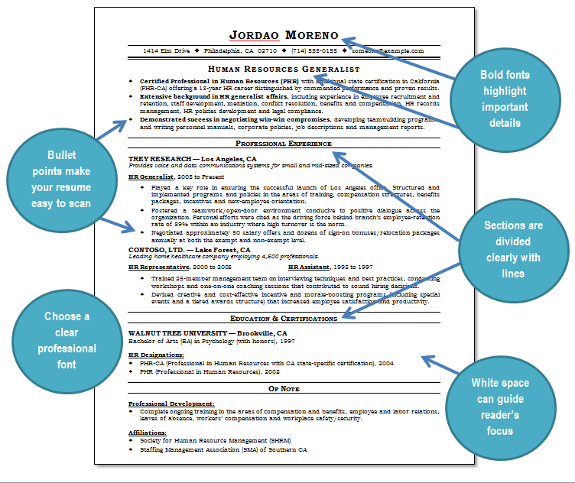
Resume Example

Slide 21
But Don’t Do These
But don’t do these!
Lie
Use multiple fonts
Pictures
Personal details
Salary requests
Typos
Unprofessional Email Address
More than 2 pages
Overuse abbreviations

Slide 22
21st Century Resumes

Slide 23
Common Formats
Common Formats
Microsoft Word Document
Printable Document Format (PDF)

Slide 24
Sending your Resume
Sending your Resume
Send as an email attachment
Submit over website
Post on online job board
Which format should you use?

